Slide 1

AWS Migration
Stephen Mouring
Director of Software Engineering
Sequoia Holdings

Slide 2

Introductions

Slide 3
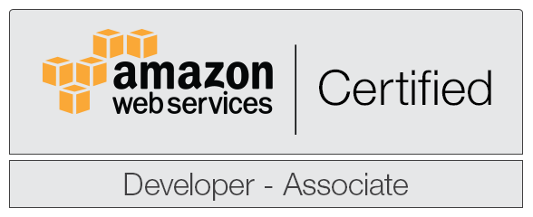
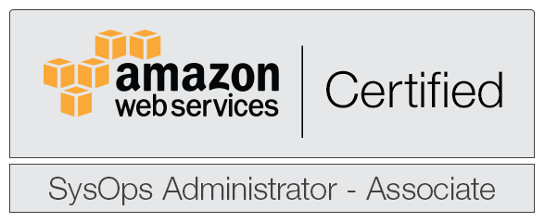
Who Am I
Software Developer for the customer for 10 years
Certified AWS Developer
Certified System Administrator
Working on DevOps Certification
Project Lead on Legacy Application Migration Cloud Project
First Production application in C2S
Involved as an advisor/observer on multiple similar efforts

Slide 4
Who Is Sequoia
Employee owned world class IT professional services firm that rewards growth and positive results
Leading provider of high-end IT, engineering and professional services
Customers:
Intelligence Community, Homeland Security & Defense, Civilian & Justice, Emerging Technology
Solutions:
AWS/C2S Development/Migration, Big Data Development, Cyber Security, Data Science & Analytics
Founded in 2012; built on uncompromising commitment to our customers and employees
Strong Leadership Team driven by entrepreneurial creativity and focused on client relationships, service and satisfaction
Venture Arm Launched in 2015 - Sequoia Apps
Startup Accelerator that provides coaching, mentoring and initial seed funding

Slide 5

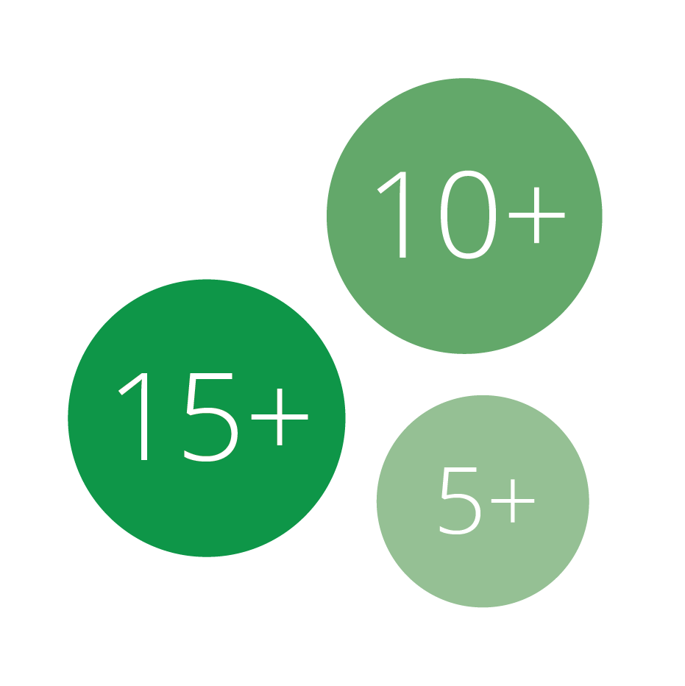
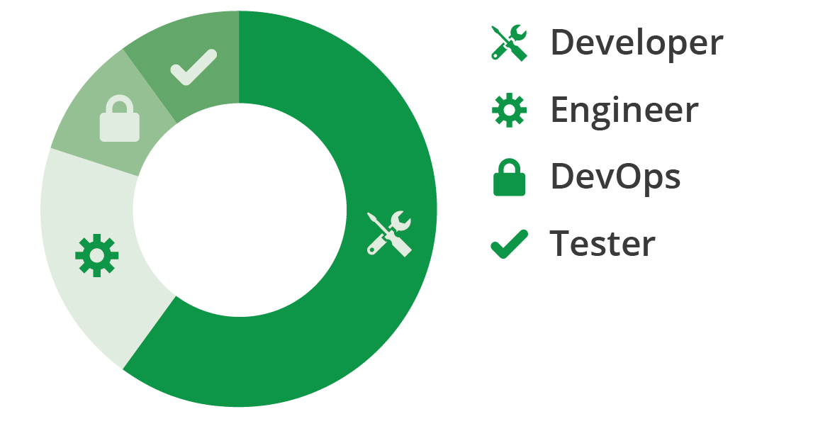
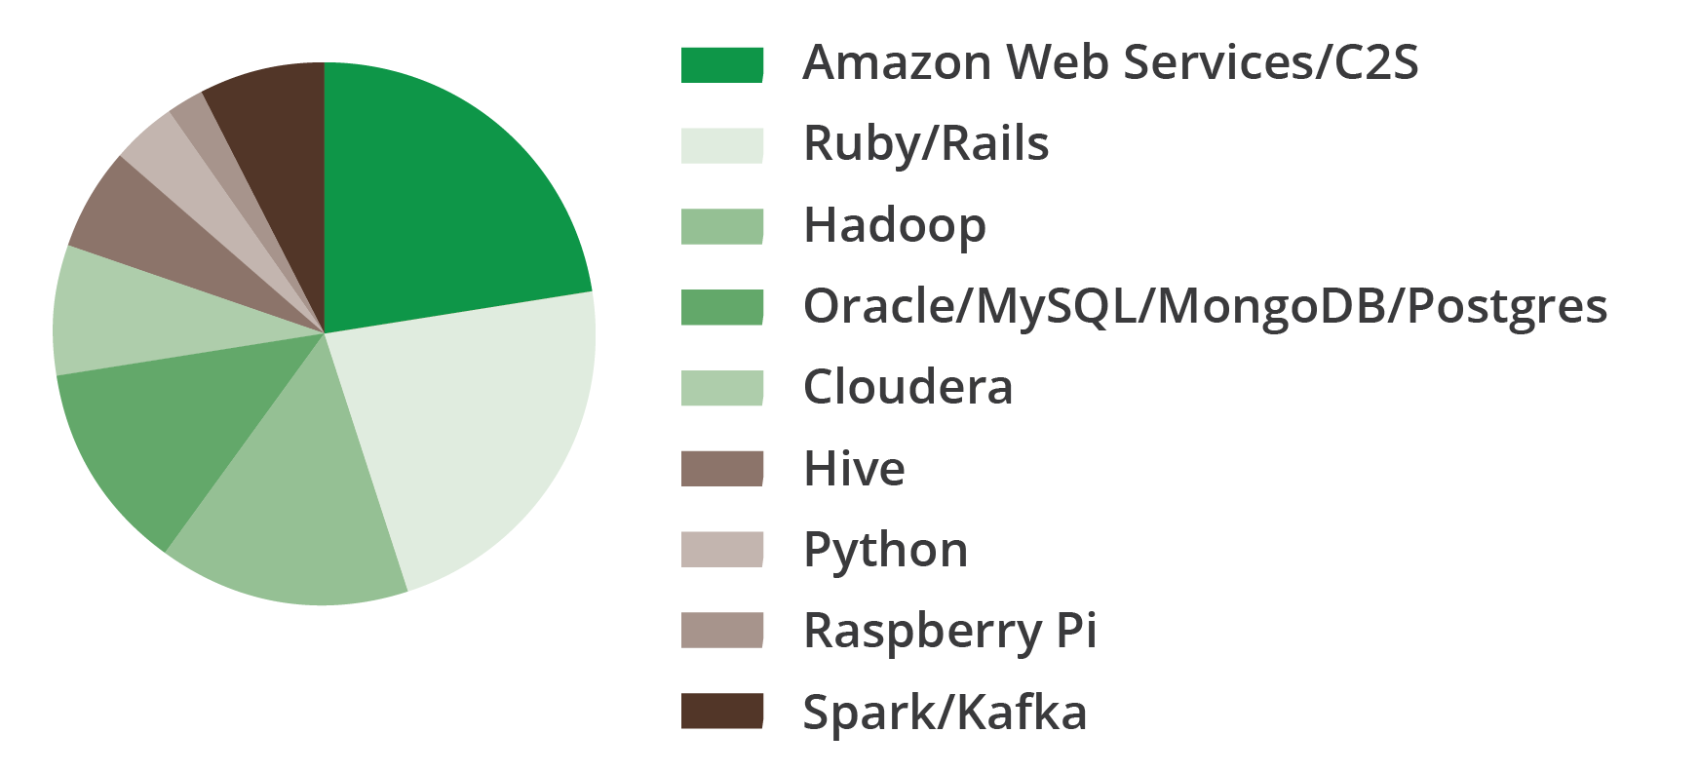
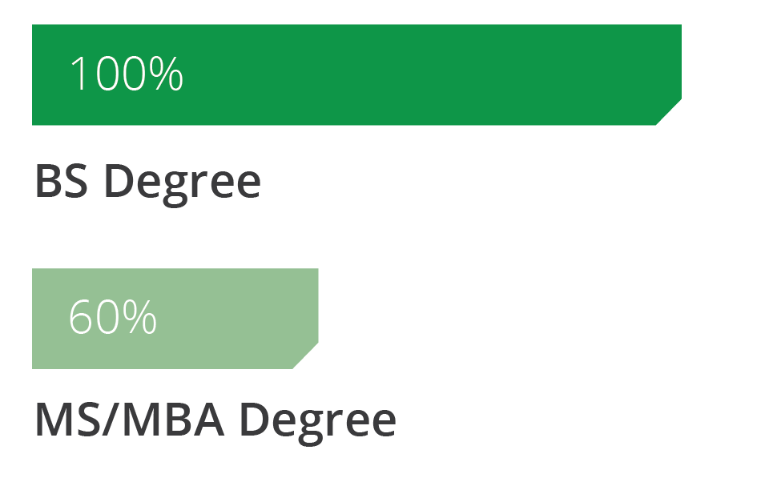
Sequoia By The Numbers
Years of Experience
Expertise
Technologies
Education

Slide 6
AWS Past Performance
Sequoia has established itself as a leader in assisting the national security sector with strategy, architecture, migration and development solutions in the AWS cloud
Experience w/ AWS support includes the US Intelligence Community and DHS
AWS past performance examples:
Application Migration Support
New Application Development
System Architecture Design and Rollout
Managed Services (DevOps)
Sequoia is a recognized Amazon Consulting Partner
Detailed Past Performance Upon Request

Slide 7
This Presentation

Slide 8
Focus on C2S
But many lessons apply to the public AWS environment as well

Slide 9
C2S Differences
Fewer things and not all things work the same way (or always very well)

Slide 10
Most on Software Architecture / Design
Some on DevOps
Less on Databases, Networking, and so forth...

Slide 11
Lessons Learned

Slide 12
Lesson Learned #1
Not everything goes in the cloud

Slide 13
Consider Sunk Costs

Slide 14
Example: Greenplum Database
Cloud cost 3 times more than buying hardware annually!

Slide 15
Example: Persistent Clusters
900 servers, 20 hour a day utilization… AWS is cheap for surges, expensive for continual use!

Slide 16
Consider Data Scale
Expensive to hold lots of data for a long time!

Slide 17
Political Pressure

Slide 18
The Cloud is not Magic

Slide 19
Lesson Learned #2
Design for Stateless Servers

Slide 20
Servers Die

Slide 21
Sometimes Amazon tells you in advance!
One of the top 10 most unsettling emails of my professional career...

Slide 22
Sometimes they die alone on the weekend...

Slide 23
AWS Paradigm:
Stateless Servers backed by Elastic Load Balancers

Slide 24
Major Architectural Change
In terms of a web application, this means no using the session!

Slide 25
Why Not Sticky Sessions?

Slide 26
Low Side:
Plausible but still dangerous

Slide 27
High Side:
You Get Either Sticky Sessions Or PKI Certificates (Not Both)

Slide 28
State Storage Hierarchy

Slide 29
Evaluate Your “State”

Slide 30
Put it on the client side
Clients re-submit information instead of caching in the session

Slide 31
(2) Use your own cookies

Slide 32
(3) Use a database

Slide 33
(4) Use a distributed cache
Consider EhCache or Tomcat Session plugin

Slide 34
Design for autoscaling
Applications should be bootstrappable and self contained

Slide 35
Lesson Learned #3
EBS is expensive!

Slide 36
EBS is familiar and easy to migrate

Slide 37
But it costs a lot
Our Project: $4 million budget, about half is spent on EBS

Slide 38
Options?

Slide 39
S3
Much cheaper… Less intuitive to work with.

Slide 40
Ephemeral
Disappears on shutdown… but it some cases (HDFS?) and applications (buffering, caching, etc.) it is viable

Slide 41
Storage Architecture Requires Planning

Slide 42
A word on RDS

Slide 43
Lesson Learned #4
Tag early tag often

Slide 44
Tags are powerful
Can be accessed and used programmatically!

Slide 45
Ability to schedule off hours shutdowns

Slide 46
Makes billing far more comprehensible

Slide 47
Support not strong in AWS
Still a manual process… but worth the investment!

Slide 48
We are growing this space

Slide 49
Example

Slide 50
First step: A linux server in AWS

Slide 51
Second step: Batch processing on web

Slide 52
Third step: Solving State problems

Slide 53
Next Steps: Integration with DevOps and Scaling

Slide 54
Take away:
Migration is a gradual process
Start small and gradually introduce complexity

Slide 55
Further Resources

Slide 56
Upcoming Whitepaper

Slide 57
Hedge Environment

Slide 58
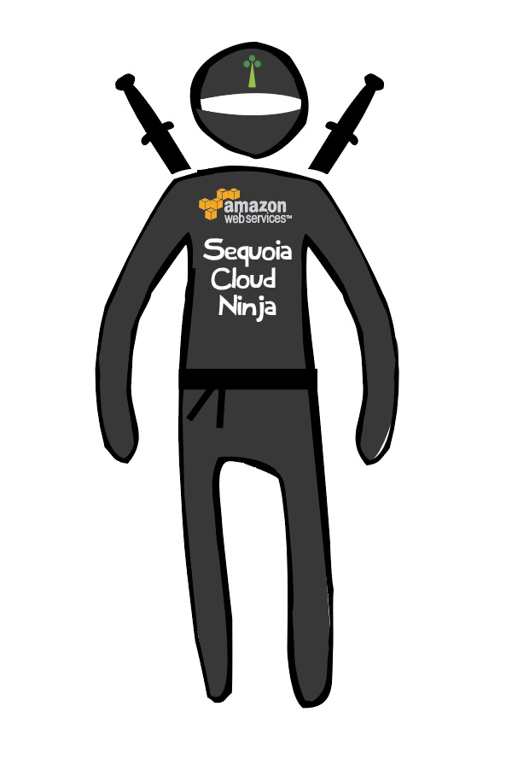
Our Experts Can Help

Slide 59
Questions?

Slide 60
For More Information
Contact Us At:
11180 Sunrise Valley Drive, Suite 110 Reston VA
571-267-7945
jobs@sequoiainc.com
Follow Us At:
Website: http://sequoiainc.com
Blog: http://blogs.sequoiainc.com/
Sequoia Apps: http://www.sequoia-apps.com/
Twitter: https://twitter.com/sequoiainc
Facebook: https://www.facebook.com/sequoiainc
LinkedIn: https://www.linkedin.com/company/sequoia-holdings-inc

